Slide 1


Team enigma
Maharaja surajmal institute of technology

Slide 2
TEAM MEMBERS
PRANESH NEGI (LEADER)
RACHNIT SINGH JONTY
VISHAL YADAV
VIPIN MALIK

Slide 3
PROBLEMS FACED BY investors
What does ‘investing in market’ mean?
What are the ways to invest money?
How high are the risks?
Can I invest anywhere?
How often does the market fluctuate?
Does ‘more profit’ means ‘more time and risk’?

Slide 4
FINLYTICS
Solutions provided by Finlytics –
Finlytics analyze the present assets of the client & suggest the best decision which they can make according to their need to make a profitable investments. The clients get a detailed report featuring net worth of their current assets & in near future if they follow our suggestions. They also take into consideration the risk associated with it.
It works with all devices ranging from smartphones and tablets to laptops and pc’s - android and ios app.

Slide 5
FEATURES PROVIDED BY FINLYTICS
Asset Calculator: From comprehensive dataset provided by the Reserve Bank of India, the calculator provides with the most reliable and profitable SIP, Lump Sum and Fixed Deposits active in India.
Stock Market: A reliable JSON API provides the monthly opening, closing, high and low values of some of the stocks in India. This API is refined and useful data is automatically stored in the database. This data is finally fetched and plotted using ML libraries.

Slide 6
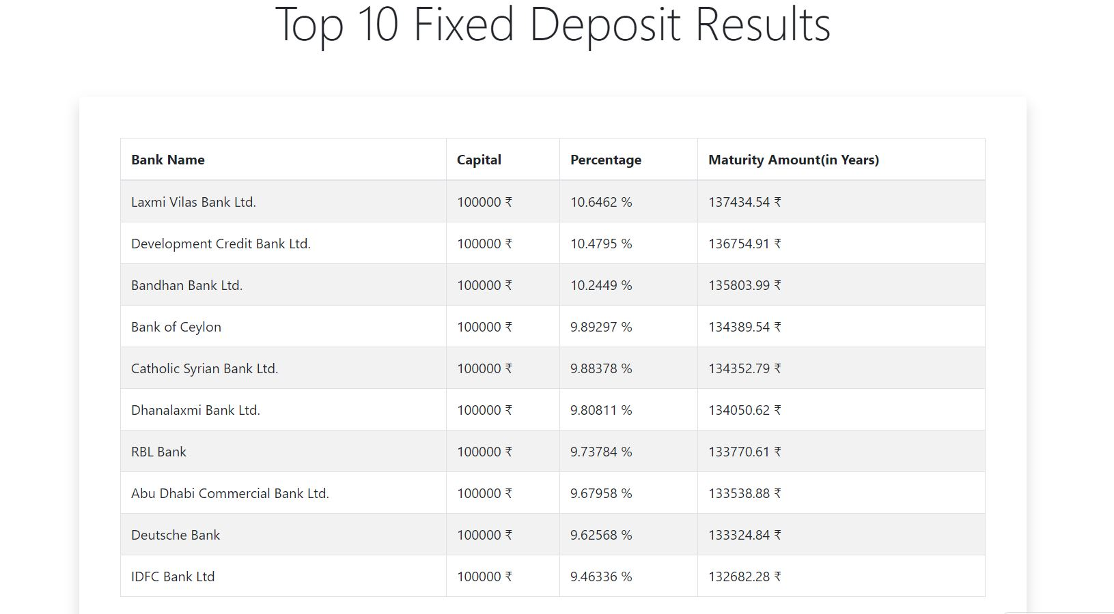
SCREENSHOTS

Slide 7
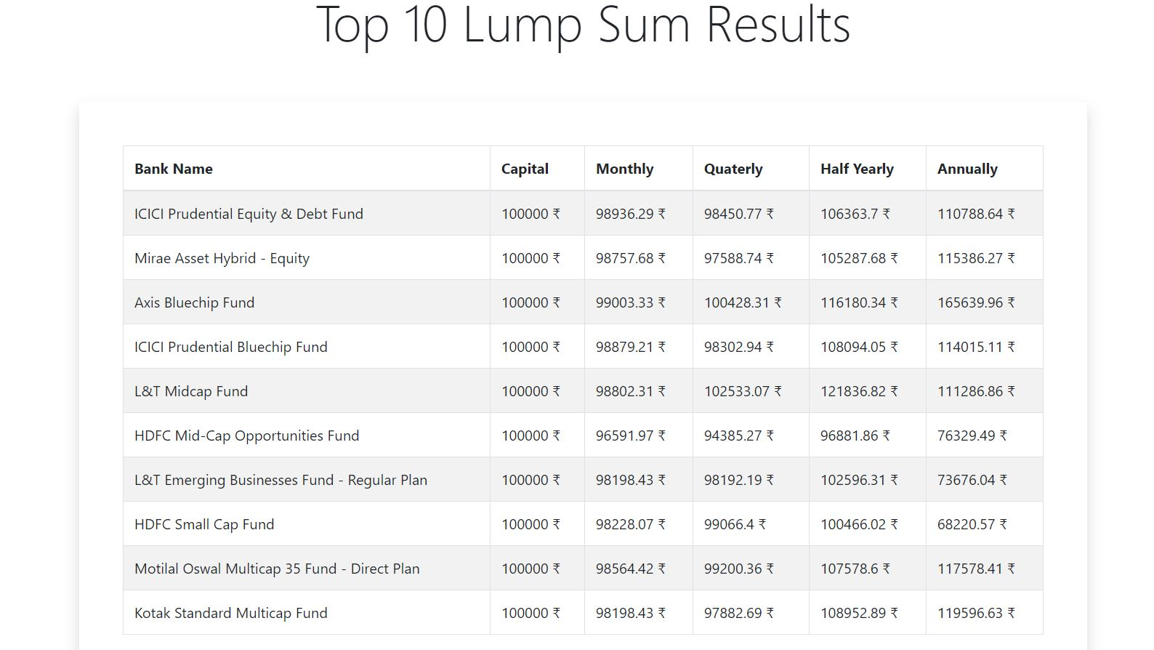

Slide 8
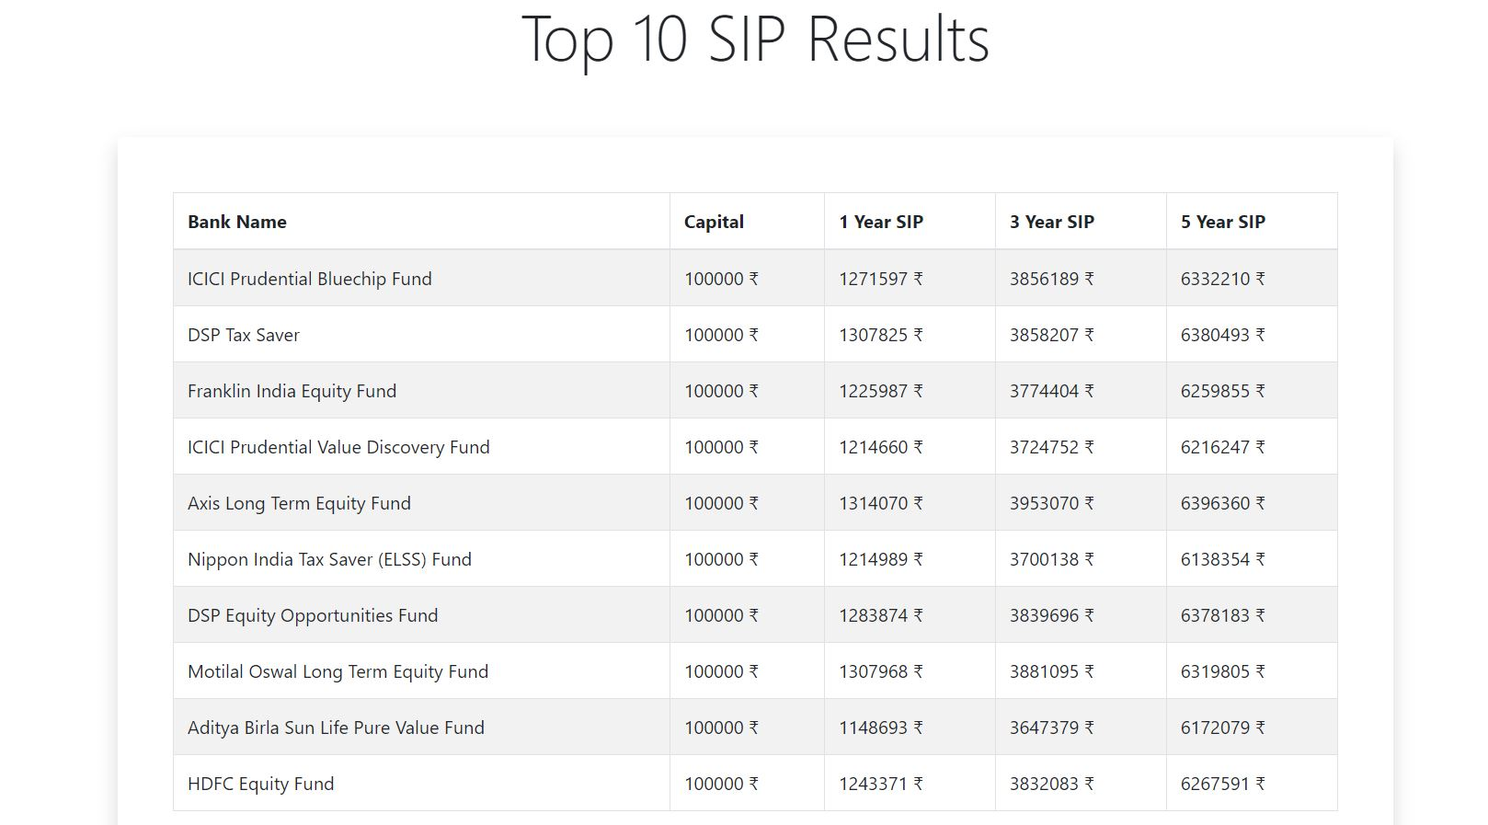

Slide 9
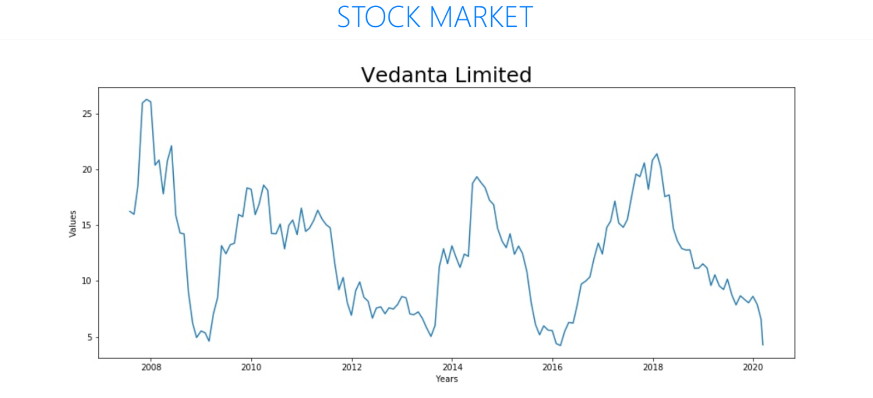
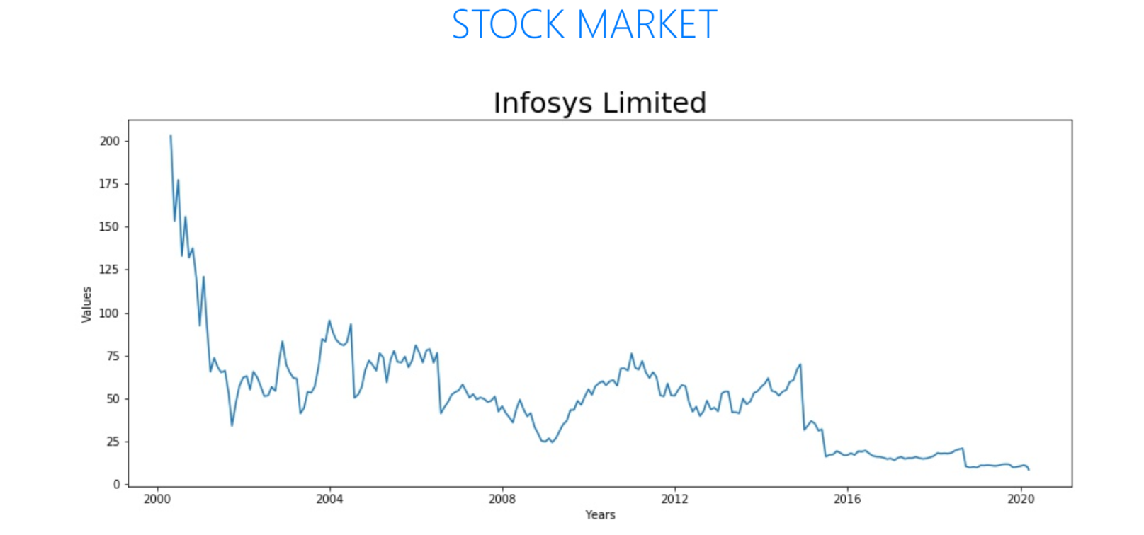

Slide 10
THANK YOU

